Slide 1
Classifying Computational Counting Problems
Pinyan Lu (陆品燕)
Shanghai University of Finance and Economics

Slide 2
Outline
Complexity Classes and Counting Problems
Dichotomy Theorems
Holographic Algorithms
Approximate Counting

Slide 3
Outline
Complexity Classes and Counting Problems
Dichotomy Theorems
Holographic Algorithms
Approximate Counting

Slide 4
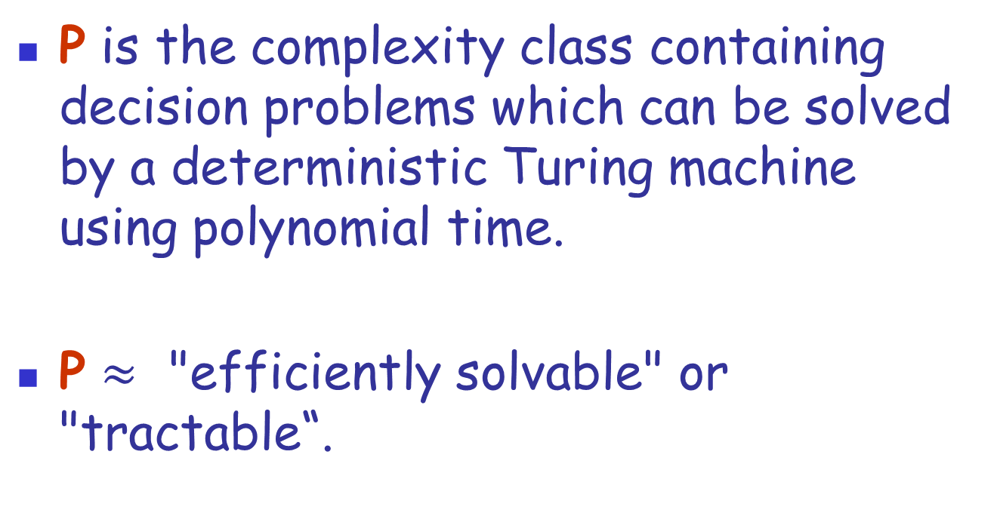
Complexity Class P
P is the complexity class containing decision problems which can be solved by a deterministic Turing machine using polynomial time.
P $≈$ "efficiently solvable" or "tractable“.

Slide 5
NP
NP is the set of decision problems solvable in polynomial time on a non-deterministic TM.
Equivalently, it is the set of problems whose solutions can be "verified" by a deterministic TM in polynomial time.
SAT, Hamiltonian cycle, Graph coloring

Slide 6
#P
#P is the set of counting problems associated with the decision problems in the set NP, counting number of solutions.
#SAT, #Hamiltonian Cycle, #Graph Coloring.
#P is at least as difficult as NP.

Slide 7



Complexity Classes
$$\#P$$
$$NP$$
$$P$$

Slide 8

Complete Problems
$$\#P$$
$NP$-Complete
$$NP$$
$$P$$

Slide 9
Complete Problems
3-Coloring
$$\#P$$
$NP$-Complete
$$NP$$
$$P$$

Slide 10
Complete Problems
3-Coloring
$$\#P$$
$NP$-Complete
$$NP$$
2-Coloring
$$P$$

Slide 11
Complete Problems
3-SAT
3-Coloring
$$\#P$$
$NP$-Complete
$$NP$$
2-SAT
2-Coloring
$$P$$

Slide 12
Complete Problems
3-SAT
3-Coloring
$$\#P$$
$NP$-Complete
$$NP$$
2-SAT
2-Coloring
$$P$$

Slide 13
Complete Problems
3-SAT
3-Coloring
$$\#P$$
Vertex Cover
Independent Set
$NP$-Complete
$$NP$$
2-SAT
2-Coloring
$$P$$

Slide 14
Complete Problems
3-SAT
3-Coloring
$$\#P$$
Vertex Cover
Independent Set
$NP$-Complete
Perfect Matching
$$NP$$
2-SAT
2-Coloring
Lin-q
$$P$$

Slide 15

Counting Problems
#$P$-Complete
#3-SAT
#3-Coloring
$$\#P$$
#Vertex Cover
#Independent Set
$NP$-Complete
#Perfect Matching
$$NP$$
#2-SAT
#2-Coloring
#Lin-q
$$P$$

Slide 16
Counting Problems
#$P$-Complete
#3-SAT
#3-Coloring
$$\#P$$
#Vertex Cover
#Independent Set
#Perfect Matching
#2-SAT
#2-Coloring
#Lin-q
$$P$$

Slide 17
Counting Problems
#$P$-Complete
#3-SAT
#3-Coloring
$$\#P$$
#Vertex Cover
#Independent Set
#Perfect Matching
#2-SAT
#2-Coloring
#Lin-q
$$P$$

Slide 18
Outline
Complexity Classes and Counting Problems
Dichotomy Theorems
Holographic Algorithms
Approximate Counting

Slide 19
Dichotomy Theorems
#$P$-Complete
#3-SAT
#3-Coloring
$$\#P$$
#Vertex Cover
#Independent Set
#Perfect Matching
#2-SAT
#2-Coloring
#Lin-q
$$P$$
#Planar Perfect Matching

Slide 20

Dichotomy Theorems
#$P$-Complete
#3-SAT
#3-Coloring
$$\#P$$
#Vertex Cover
#Independent Set
#Perfect Matching
#2-SAT
#2-Coloring
#Lin-q
$$P$$
#Planar Perfect Matching
S$ome Framework$

Slide 21
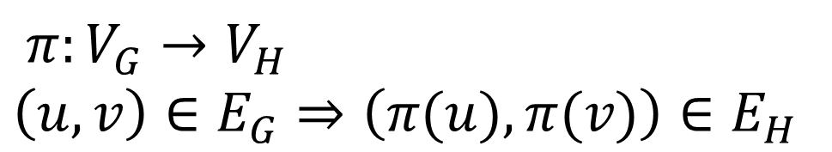


Graph Homomorphisms
$$π:V_{G}→V_{H}$$
$$\left(u,v\right)∈E_{G}⇒\left(π(u),π(v)\right)∈E_{H}$$
$$G$$
$$H$$

Slide 22
Graph Homomorphisms
$$π:V_{G}→V_{H}$$
$$\left(u,v\right)∈E_{G}⇒\left(π(u),π(v)\right)∈E_{H}$$
$$G$$
$$H$$

Slide 23


Graph Homomorphisms
$$π:V_{G}→V_{H}$$
$$\left(u,v\right)∈E_{G}⇒\left(π(u),π(v)\right)∈E_{H}$$
$$G$$
$$H$$

Slide 24
Graph Homomorphisms
$$π:V_{G}→V_{H}$$
$$\left(u,v\right)∈E_{G}⇒\left(π(u),π(v)\right)∈E_{H}$$
$$G$$
$$H$$

Slide 25
Graph Homomorphisms
$$π:V_{G}→V_{H}$$
$$\left(u,v\right)∈E_{G}⇒\left(π(u),π(v)\right)∈E_{H}$$
$$G$$
$$H$$

Slide 26
Graph Homomorphisms
$$π:V_{G}→V_{H}$$
$$\left(u,v\right)∈E_{G}⇒\left(π(u),π(v)\right)∈E_{H}$$
$$G$$
$$H$$

Slide 27
Dichotomy Theorem
[Dyer, Greenhill 00]
The counting graph homomorphisms problem is
  in P if each connect component of H is either a complete graph with self-loops
  or a complete bipartite graph;
  #P-complete otherwise.

Slide 28
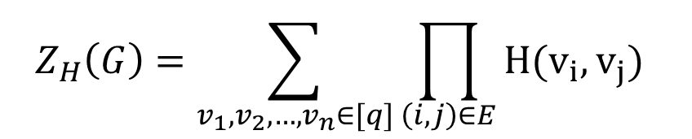
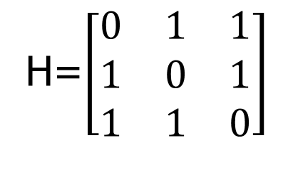
Graph Homomorphisms
$$π:V_{G}→V_{H}$$
$$\left(u,v\right)∈E_{G}⇒\left(π(u),π(v)\right)∈E_{H}$$
#3-coloring
H=$\left[\begin{matrix}0 & 1 & 1 \\ 1 & 0 & 1 \\ 1 & 1 & 0\end{matrix}\right]$
$$Z_{H}\left(G\right)=\sum_{v_{1},v_{2},…{,v}_{n}∈[q]}{\prod_{\left(i,j\right)∈E}{H(v_{i}, v_{j})}}$$

Slide 29
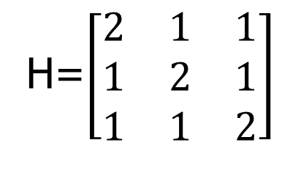
Weighted Graph Homomorphisms
Spin systems in Statistic Physics
Graphical models in machine learning
H=$\left[\begin{matrix}2 & 1 & 1 \\ 1 & 2 & 1 \\ 1 & 1 & 2\end{matrix}\right]$
$$Z_{H}\left(G\right)=\sum_{v_{1},v_{2},…{,v}_{n}∈[q]}{\prod_{\left(i,j\right)∈E}{H(v_{i}, v_{j})}}$$
partition function

Slide 30
Weighted Graph Homomorphisms
[Bulatov, Grohe 05]
Let H be a symmetric non-negative matrix. Then it is #P-hard to compute the partition function unless each connect component of H is of rank 1 or bipartite rank 2.
block-rank-one structure

Slide 31
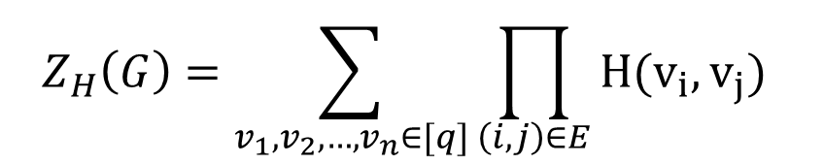
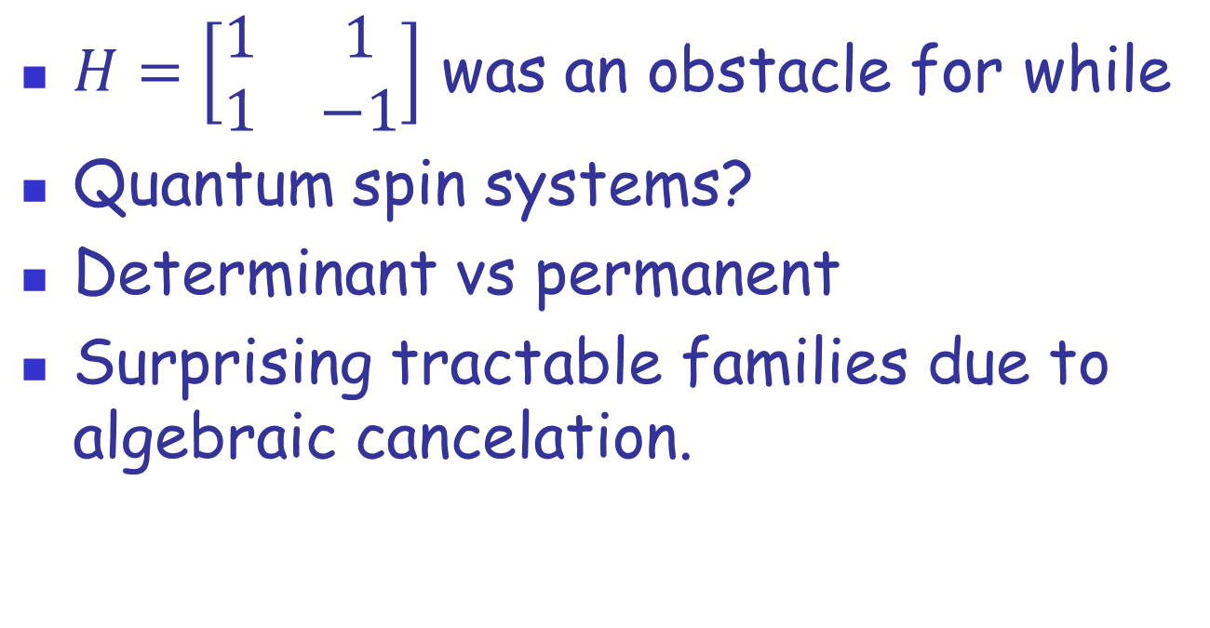
Negative and complex weight?
$H=\left[\begin{matrix}1 & 1 \\ 1 & −1\end{matrix}\right]$ was an obstacle for while
Quantum spin systems?
Determinant vs permanent
Surprising tractable families due to algebraic cancelation.
$$Z_{H}\left(G\right)=\sum_{v_{1},v_{2},…{,v}_{n}∈[q]}{\prod_{\left(i,j\right)∈E}{H(v_{i}, v_{j})}}$$

Slide 32
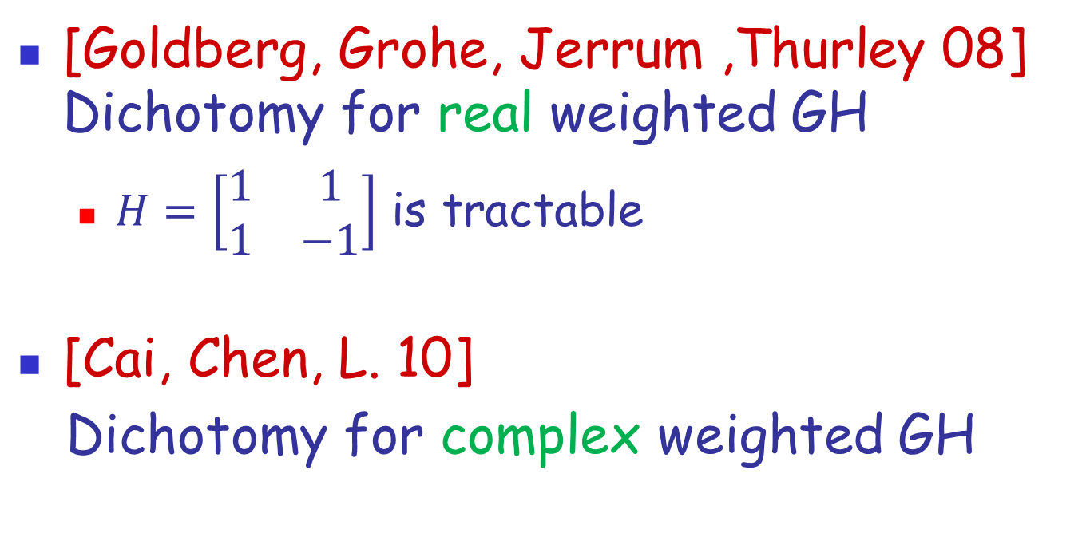
Real and complex weight
[Goldberg, Grohe, Jerrum ,Thurley 08] Dichotomy for real weighted GH
  $H=\left[\begin{matrix}1 & 1 \\ 1 & −1\end{matrix}\right]$ is tractable
[Cai, Chen, L. 10]
Dichotomy for complex weighted GH

Slide 33
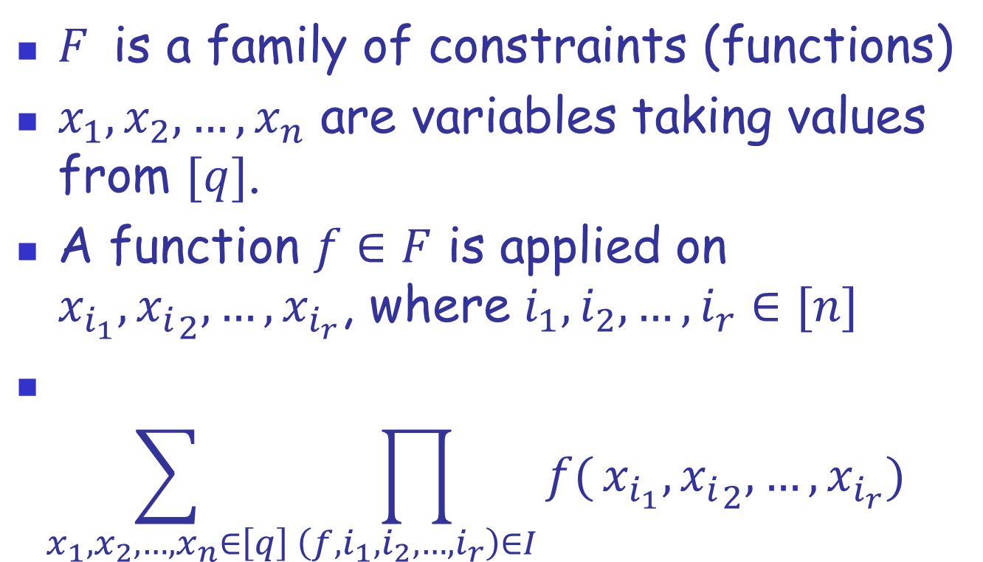
Counting CSP
$F$is a family of constraints (functions)
$x_{1}, x_{2}, …,x_{n}$ are variables taking values from $[q]$.
A function $f∈F$ is applied on $x_{i_{1}},{x_{i}}_{2},…,x_{i_{r}}$, where $i_{1},i_{2},…,i_{r}∈[n]$
$$\sum_{x_{1}, x_{2}, …,x_{n}∈\left[q\right]}{\prod_{\left(f,i_{1},i_{2},…,i_{r}\right)∈I}{f(}}x_{i_{1}},{x_{i}}_{2},…,x_{i_{r}})$$

Slide 34
Boolean #CSP
[Creignou, Hermann 96] All the functions in F take values in {0,1} (unweighted).
[Dyer, Goldberg, Jerrum 07] non-negative values.
[Bulatov, Dyer, Goldberg, Jalsenius, Richerby 09] real values.
[Cai, L., Xia 09] complex values.

Slide 35
#CSP
[Bulatov 08] Unweighted case
[Dyer, Richerby 10, 11] Alternative proof and decidable dichotomy
[Cai, Chen, L. 11] Non-negative weighted functions

Slide 36
Dichotomy for weighted #CSP
[Cai, Chen, L. 11]
The problem is #P-Hard unless any realizable function (after being viewed as a binary function) is of block-rank-1, in which case it is in P.

Slide 37
Further Classify the Hard Problems
Some may become tractable when we have some restriction for the input instances.
Some may become tractable if we are satisfied with an approximation answer.
Some remains hard.

Slide 38
Outline
Complexity Classes and Counting Problems
Dichotomy Theorems
Holographic Algorithms
Approximate Counting

Slide 39
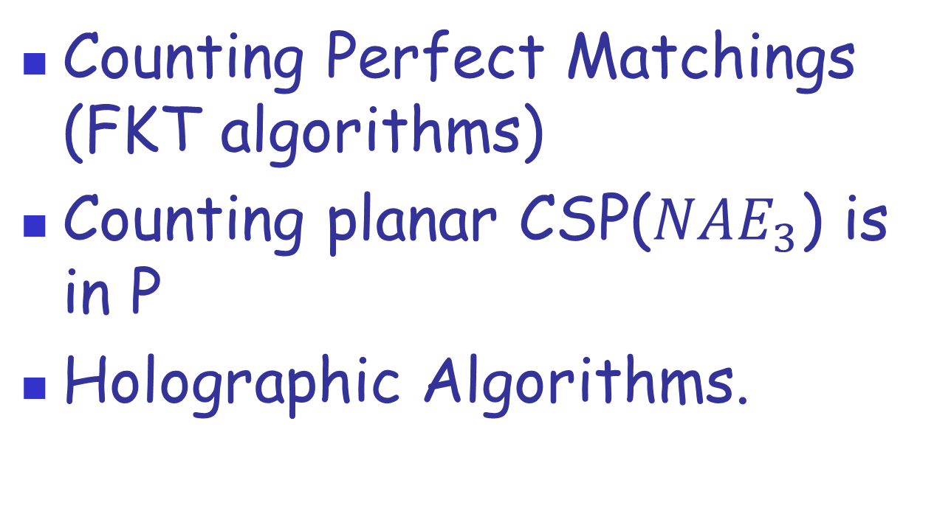
Counting for planar instances
Counting Perfect Matchings (FKT algorithms)
Counting planar CSP($NAE_{3}$) is in P
Holographic Algorithms.

Slide 40
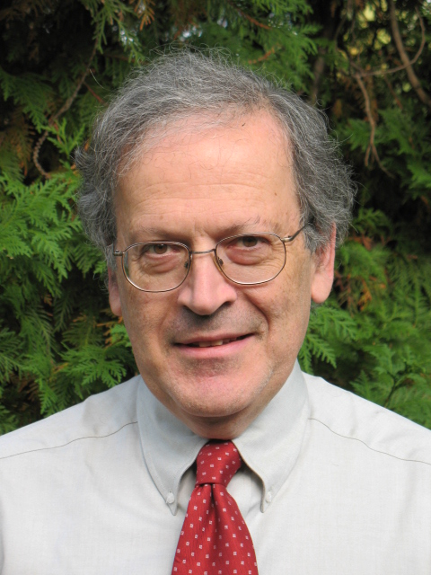
Holographic Algorithms by Valiant
L. Valiant

Slide 41
A new algorithms design method
Like linear programming, dynamic programming, and so on.
Some seemingly exponential time computations can be done in polynomial time.
Custom made exponential cancellations.
It produces an exponential number of solution fragments in a pattern of interference, analogous to quantum computing.

Slide 42
A high level description
Formulate the given problem as some vectors and the final value as an inter product of vectors.
Find a basis transformation T such that the all these vectors (after transformation) can be encoded by some gadget on planar perfect matchings.
Solve the problem by FKT algorithm

Slide 43
Art or Science?
“Accidental Algorithms” [Valiant @ FOCS 2006]
“A strange new family of algorithms probes the boundary between easy and hard problems” [An article from American Scientist Magazine]

Slide 44
Infinite Search Space
Formulate the given problem as some vectors and the final value as an inter product of vectors.
Find a basis transformation T such that the all these vectors (after transformation) can be encoded by some gadget on planar perfect matchings.
Solve the problem by FKT algorithm

Slide 45
From Art to Science
Joint with Jin-Yi Cai, we have
Matchgate Identities [@CCC 2007]
Basis Collapse Theorem [@ICALP 2007]
A general algorithm to design holographic algorithms [@STOC 2007]

Slide 46
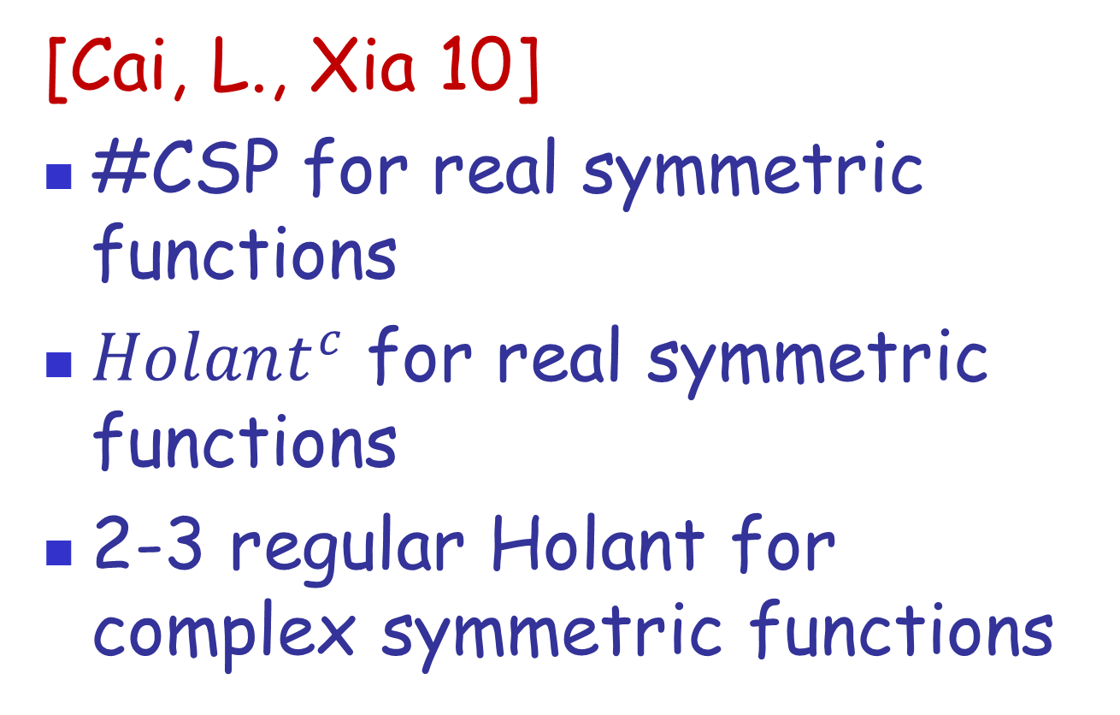
Three Trichotomy Theorems
[Cai, L., Xia 10]
#CSP for real symmetric functions
$Holant^{c}$ for real symmetric functions
2-3 regular Holant for complex symmetric functions

Slide 47
Trichotomy theorems
Hard even for planar graphs
Hard for general graphs but tractable for planar graphs by holographic algorithms
Tractable for general graphs

Slide 48
Outline
Complexity Classes and Counting Problems
Dichotomy Theorems
Holographic Algorithms
Approximate Counting

Slide 49
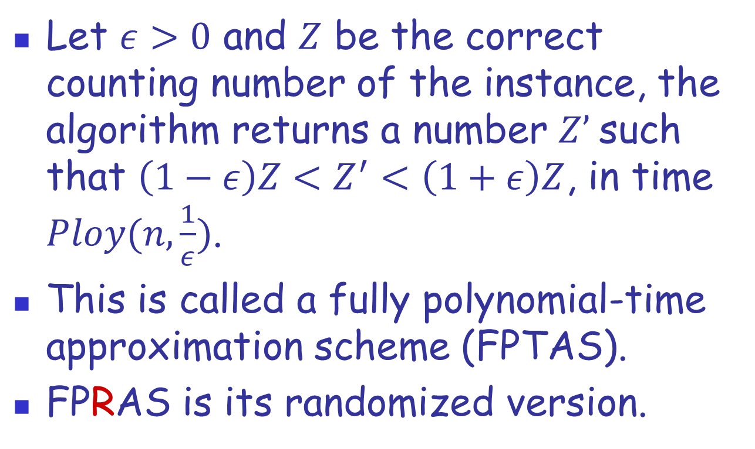
Approximate counting
Let $ε>0$ and $Z$ be the correct counting number of the instance, the algorithm returns a number $Z’$such that $\left(1−ε\right)Z<Z^{′}<\left(1+ε\right)Z$, in time $Ploy(n,\frac{1}{ε})$.
This is called a fully polynomial-time approximation scheme (FPTAS).
FPRAS is its randomized version.

Slide 50
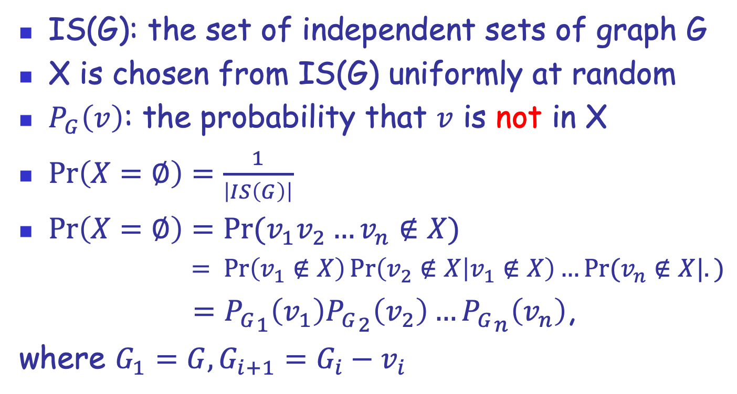
Counting vs Distribution
IS(G): the set of independent sets of graph G
X is chosen from IS(G) uniformly at random
$P_{G}\left(v\right)$: the probability that $v$ is not in X
$\operatorname{Pr}\left(X=∅\right)=\frac{1}{\left|IS\left(G\right)\right|}$
$\operatorname{Pr}\left(X=∅\right)=\operatorname{Pr}{(v_{1}v_{2}…v_{n}∉X)}$
$= Pr\left(v_{1}∉X\right)\operatorname{Pr}\left(v_{2}∉X | v_{1}∉X\right)…Pr⁡(v_{n}∉X|.)$
$={P_{G}}_{1}\left(v_{1}\right){P_{G}}_{2}\left(v_{2}\right)…{P_{G}}_{n}\left(v_{n}\right)$,
where $G_{1}=G, G_{i+1}=G_{i}−v_{i}$

Slide 51
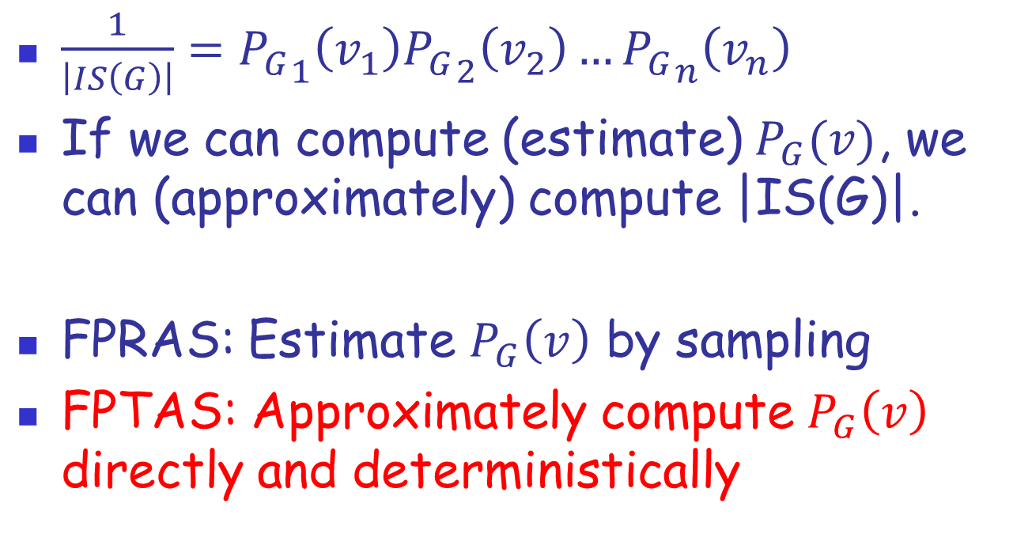
Counting vs Distribution
$\frac{1}{\left|IS\left(G\right)\right|}={P_{G}}_{1}\left(v_{1}\right){P_{G}}_{2}\left(v_{2}\right)…{P_{G}}_{n}\left(v_{n}\right)$
If we can compute (estimate) $P_{G}(v)$, we can (approximately) compute |IS(G)|.
FPRAS: Estimate $P_{G}\left(v\right)$ by sampling
FPTAS: Approximately compute $P_{G}\left(v\right)$ directly and deterministically

Slide 52

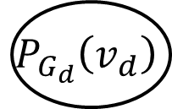



Computation Tree
Relate the probability $P_{G}\left(v\right)$ to these of its neighbors in smaller instances.
$P_{G}\left(v\right)=f(P_{G_{1}}\left(v_{1}\right),P_{G_{2}}\left(v_{2}\right), …,P_{G_{d}}\left(v_{d}\right))$
$$P_{G}\left(v\right)$$
$$P_{G_{1}}\left(v_{1}\right)$$
$$P_{G_{2}}\left(v_{2}\right)$$
$$P_{G_{d}}\left(v_{d}\right)$$

Slide 53
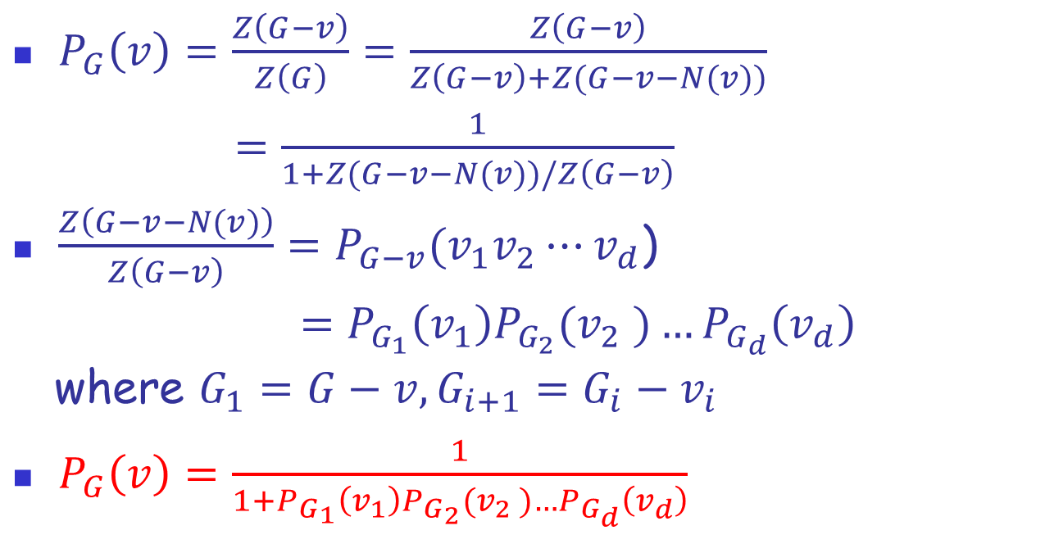
An example of independent sets
$P_{G}\left(v\right)=\frac{Z\left(G−v\right)}{Z\left(G\right)}=\frac{Z\left(G−v\right)}{Z\left(G−v\right)+Z(G−v−N(v))}$
$=\frac{1}{1+Z(G−v−N(v))/Z\left(G−v\right)}$
$\frac{Z\left(G−v−N(v)\right)}{Z\left(G−v\right)}=P_{G−v}(v_{1}v_{2}⋯v_{d}$)
$=P_{G_{1}}\left(v_{1}\right)P_{G_{2}}(v_{2} )…P_{G_{d}}\left(v_{d}\right)$
where $G_{1}=G−v, G_{i+1}=G_{i}−v_{i}$
$P_{G}\left(v\right)=\frac{1}{{1+P}_{G_{1}}\left(v_{1}\right)P_{G_{2}}(v_{2} )…P_{G_{d}}\left(v_{d}\right)}$

Slide 54
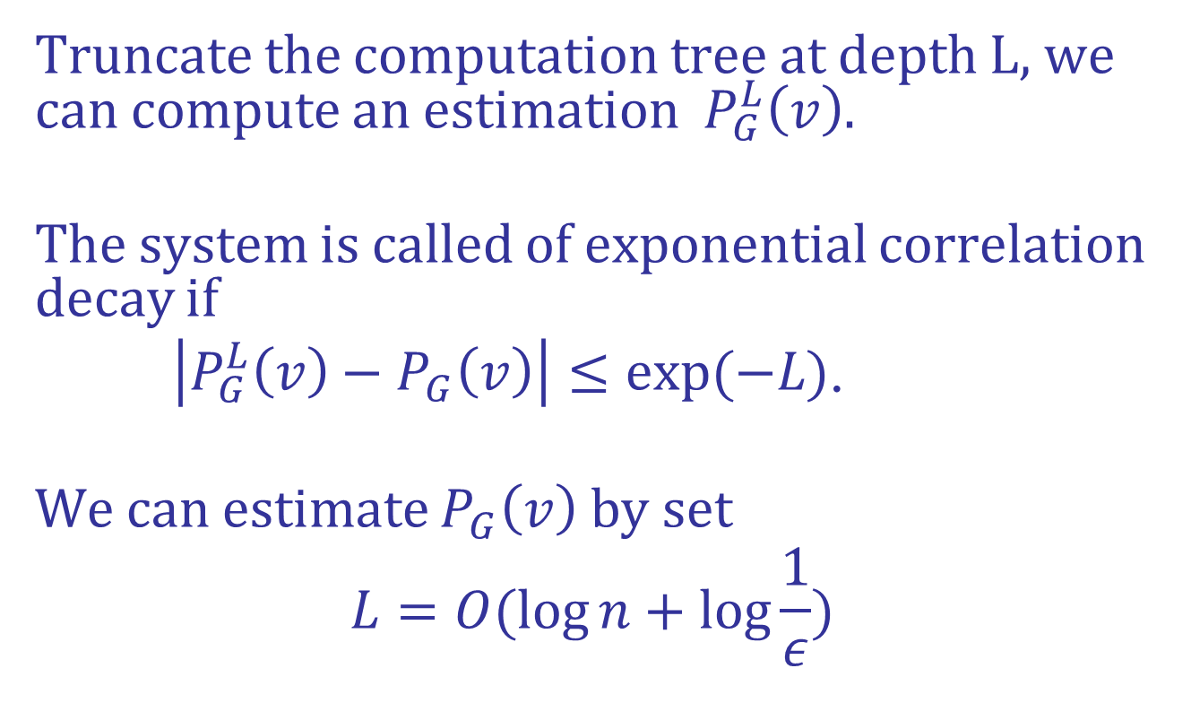
Correlation Decay
Truncate the computation tree at depth L, we can compute an estimation $P_{G}^{L}\left(v\right)$.
The system is called of exponential correlation decay if
$\left|P_{G}^{L}\left(v\right)−P_{G}\left(v\right)\right|≤exp(−L)$.
We can estimate $P_{G}\left(v\right)$ by set
$$L=O(\log{n+\log{\frac{1}{ε}})}$$

Slide 55
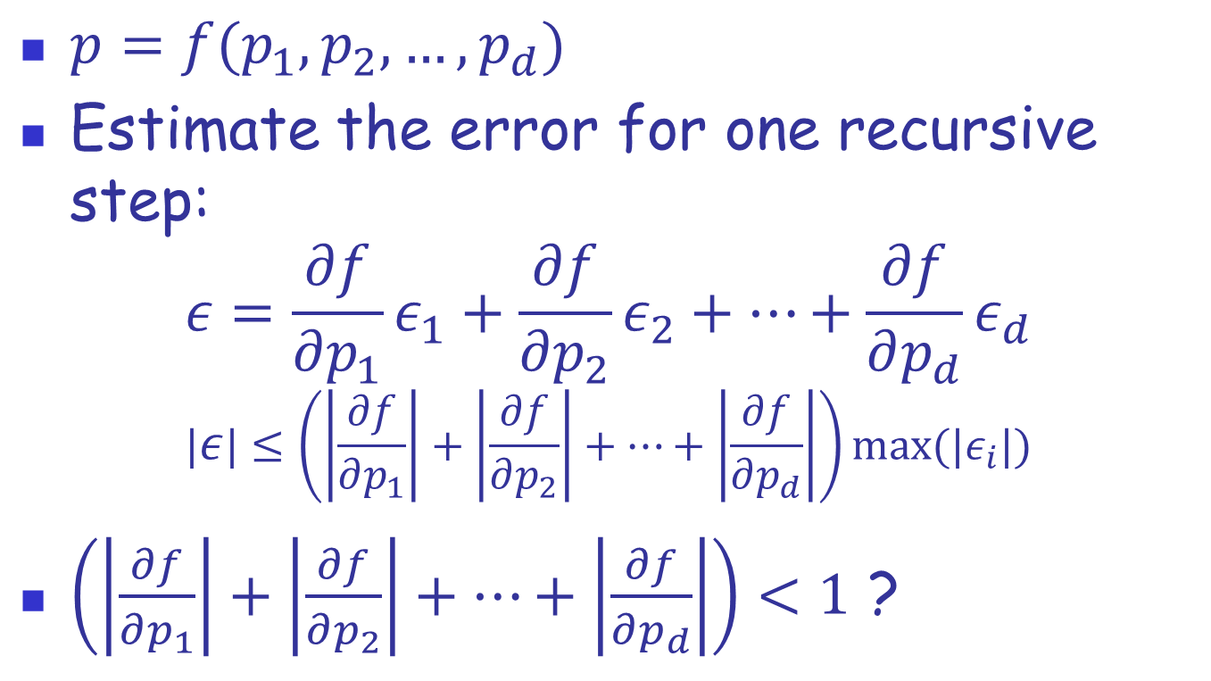
Proof Sketch for Correlation Decay
$p=f(p_{1}, p_{2}, …,p_{d})$
Estimate the error for one recursive step:
$$ε=\frac{∂f}{∂p_{1}}ε_{1}+\frac{∂f}{∂p_{2}}ε_{2}+…+\frac{∂f}{∂p_{d}}ε_{d}$$
$$|ε|≤\left(\left|\frac{∂f}{∂p_{1}}\right|+\left|\frac{∂f}{∂p_{2}}\right|+…+\left|\frac{∂f}{∂p_{d}}\right|\right)max⁡({|ε}_{i}|)$$
$\left(\left|\frac{∂f}{∂p_{1}}\right|+\left|\frac{∂f}{∂p_{2}}\right|+…+\left|\frac{∂f}{∂p_{d}}\right|\right)<1$ ?

Slide 56
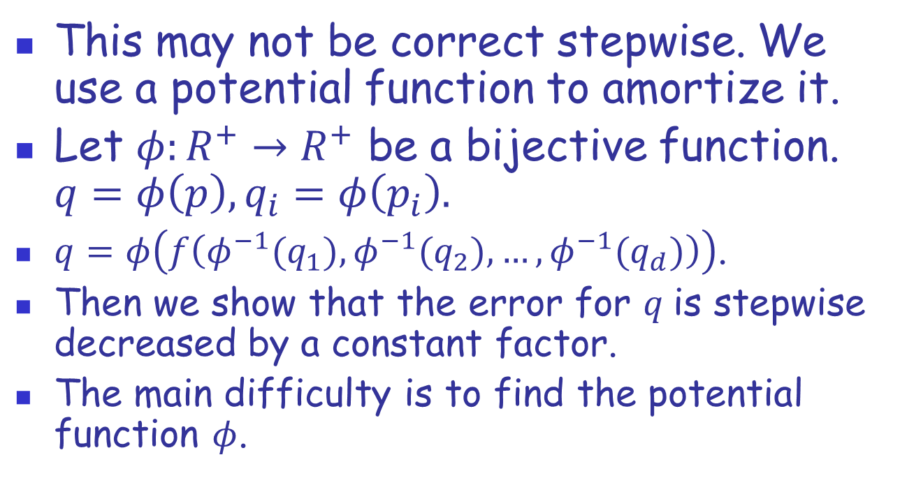
Potential Function
This may not be correct stepwise. We use a potential function to amortize it.
Let $φ:R^{+}→R^{+}$ be a bijective function. $q=φ\left(p\right),q_{i}=φ\left(p_{i}\right).$
$q=φ\left(f\left({φ^{−1}(q}_{1}),{φ^{−1}(q}_{2}), …,{φ^{−1}(q}_{d})\right)\right)$.
Then we show that the error for $q$is stepwise decreased by a constant factor.
The main difficulty is to find the potential function $φ$.

Slide 57
Outline
Complexity Classes and Counting Problems
Dichotomy Theorems
Holographic Algorithms
Approximate Counting

Slide 58
Thank You!

